Slide 1


"Auto-Evaluation of Tenders using Artificial Intelligence / Machine Learning at Mahanadi Coalfields Limited”
Joint Collaboration between IIT (ISM) Dhanbad and MCL
Notes:
CMD, Director Finance, Dir Technical Projects & Planning

Slide 2
Team Members
PI and Project Mentor from IIT-ISM
Dr. Siddhartha Agarwal
Assistant professor
Mining Department
Team Members from MCL:
1. Shri. Bishwajit Pattnaik, Chief Manager (MM), E-Procurement Cell, MCL HQ (Project Proponent)
2. Shri. Sushanta Kumar Mishra, Chief Manager (Mining), CMC Department, MCL HQ
3. Shri. Anil Kumar Beniwal, Manager (Systems), MCL HQ
4. Ms. C B Smita, Dy. Manager (MM), E-Procurement Cell, MCL HQ
Notes:
Detailed Brief is provided in the document ( Academic Backgr + Industrial Exp)

Slide 3
01. Mahanadi Coalfields Ltd A Brief introduction
Mahanadi Coalfields Ltd is one of the nine subsidiary companies of Coal India Ltd, which is a Maha Ratna PSU and largest Coal Producing company of the world.
MCL is the first PSU to avail the e-Procurement Services of NIC way back in 2009
MCL e-Procurement portal(https://mcltenders.nic.in) was shifted and merged with the portal of its parent organization Coal India e-Procurement portal URL > https://coalindiatenders.nic.in w.e.f 01.01.2017
MCL publishes approximately 2500 tenders per year valuing Rs 2500- 3000 crores per year
It has 25 Coal mines spread across the state of Orissa
Manpower -22000 (approx.)
Profit before Taxes – Rs 6000 Crores( Approx)
Production of Coal – 139 Million Tonnes last year
Notes:
MCL has been really the harbinger of e-procurement development process in Coal India and hence would certainly like to remain the forerunner in this
Secondly the amount of tenders tell that this is a major problem this proposal is going to tackle

Slide 4
01. IIT (ISM) Dhanbad A Brief Introduction
Established in 1926 (in the pattern of Royal School of Mines, London)
18 Faculty Departments
Centers of Excellence (Mining Environment, Longwall mine mechanization, Rock Excavation)
Admission of students:
Undergraduate: IIT-JEE (all India level)
Post-graduate/Research scholars : GATE/NET/ISM EE(all India level)
No. of students: 5706
– Undergraduate:3640
– Post-Graduate: 1305
– Research Scholars: 761
No. of faculty members : 251
Core strengths: Mining, Petroleum, Mining Machinery, Mineral, Mining Environment, Applied
Geology, and Applied Geophysics
International Collaborations: 14 (recent one: Politecnico di Torino, Italy, European Commission)
Special recognition: Establishment of Institute of Mining for Afghanistan, Mineral Resources Planning for Bangladesh, Global mining initiative, Ministry of Ontario Province, Canada
Notes:
The IIT (ISM) Dhanbad has bagged the 26th rank with an overall score of 74.1 in the QS World University Rankings 2022 for the mineral and mining engineering discipline and is second in the country in this subject domain.

Slide 5
02. Background of e-Procurement at CIL continued..
Award of work through finalization of tenders is one of the most important business activities of MCL as most of the work is executed through contractual mode. This involves dealing with considerable amount of public money.
While evaluating bids in each tender, it is imperative to follow extant procurement guidelines, draw decision making foundations from precedence and apply complete fairness for equal opportunity of business to prospective bidders.
The other part i.e., technical bid evaluation, by the overall system is limited to online collection of technical documents and thereafter undergoing manual evaluation.
Though transparency and speed is achieved in the process of tender participation, there exists scope to improve the evaluation process and make final recommendations.

Slide 6
03. Broad Objectives
Development of a software module which will be able to evaluate tenders and provide recommendations based on extant procurement guidelines.
The software module shall be able to refer to precedence/legacy in work awarded earlier and basis of extra-ordinary decisions taken if any. It should be able to tag and perform analogous analysis and summarize the same.
The module shall have the flexibility of being used either as a web extension over e-procurement of Coal India Limited and GeM portal or as a standalone software package; wherein, documents from these portals may be uploaded and recommendations can be made automatically
The software module shall reasonably eliminate manual engagement in the tender evaluation process as far as possible.
Software shall be up-gradable to any revision in procurement guidelines or any other policy guidelines that affects the extant evaluation process/criteria.
Development of manpower for upkeep of the system including handling of minor maintenance of the developed system

Slide 7
Tech TCR NIT-164 WORK DESCRIPTION SHOULD MATCH IN ALL BIDDING DOCUMENTS, Date when NIT was released, Amount and Quantum of work
Part-l (Tech) TCR of NIT-1O4
Sub: Tender Committee Recommendation for the job of "Hiring of HEMMs (Shovels, Dumpers, Drills, Dozers, Graders, Fog Canons etc.) for transfer & transportation of materials in various strata including drilling, excavation, dumping, spreading, dozing and other allied works in specified areas for dumping for exposing various coal seams from surface, down to seam ll B at Ananta OCP as per the instructions of Project Officer/Management of Ananta OCP, Jagannath Area, MCL, for a quantity of 559,90,000 Cu.M. (NlT-164 DT. 08.12.2020). amounting to Rs.636,53,68,8721-(Rupees Six Hundred Thirty-six Crore Fifty-three Lakh Sixty-eight Thousand Eight Hundred Seventy two) only for a period of 12460 (One Thousand Four Hundred Sixty) days.

Slide 8
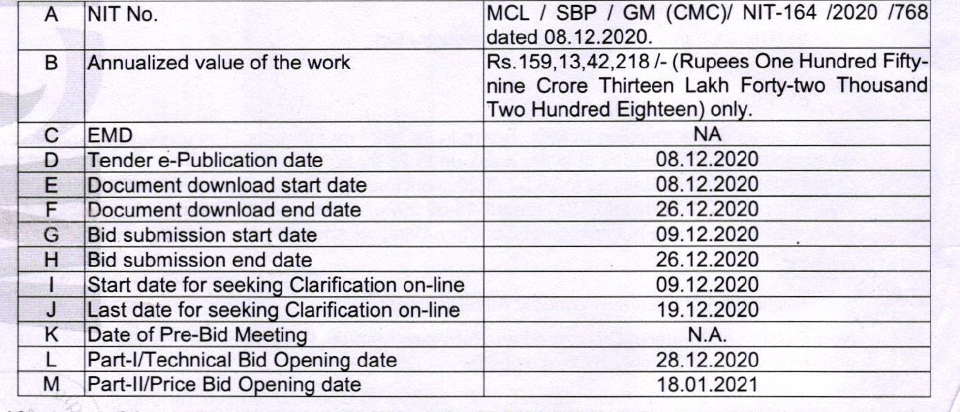
SALIENT FEATURES OF NIT:

Slide 9
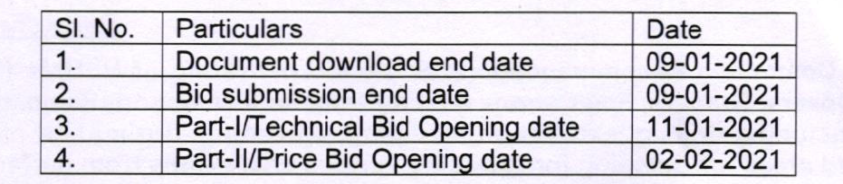
Important dates to be read

Slide 10
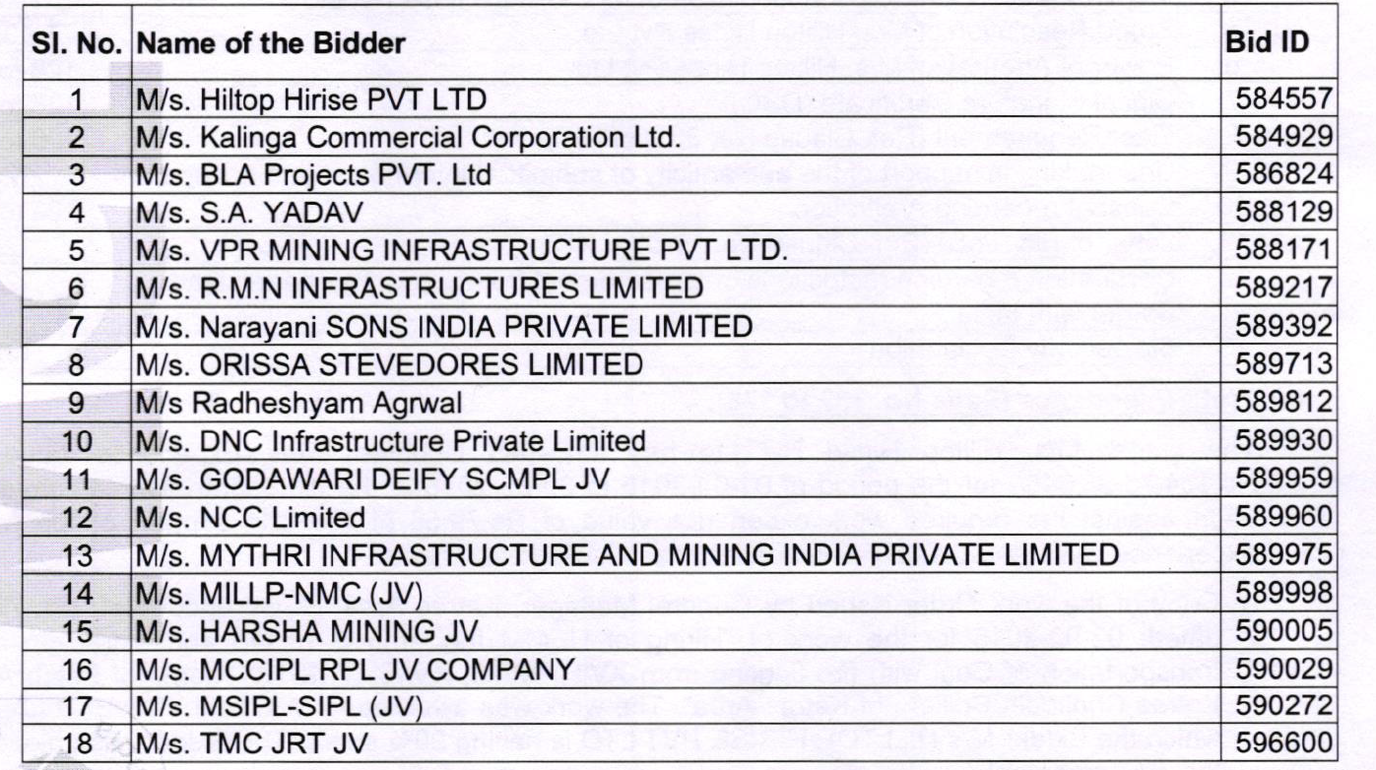
Number of Bidders, Names and their BID ID’s

Slide 11
Joint Venture under ELIGIBILITY OF BIDDERS
No of Bidders ( should not be more than 3 bidders)
Percentage Participation: 25%
Look for Keywords ( except for individuals) such as JV, partnership, firm, company etc.
Lead member P1 (Partner 1) should have 50% or more whereas P2 and P3 should have a minimum of 20% ; Keywords “LEAD PARTNER”
KEYWORDS to look for “ Participation share” & “ Work responsibilities”
Title of the work in NIT should match exactly
Bidder name of the Joint venture should match exactly given “MSIPL-SIPL(JV)
Name of the JV
Format has to be matched (all the agreement should match the format by MCL). Each line within all paragraphs should match

Slide 12
LEGAL DOCUMENT
CIN- certificate of incorporation Number
Public/Private company ( both are acceptable)
“Partnership” and “deed” Keywords
Self declaration OF PROPRIETORSHIP
“Companys ACT” Keyword
Each partner within the JV establish LEGAL STATUS
Partnership deed
Public/Private company

Slide 13
Work Experience
Calculation of Annualized value :
If work is less than 365 days then 50% of the total tender value
If work is more than 365 days
(50 crs/500 days)* 365 >= 50% of the annualized tender value
Period should match the online declared period (continuous period 365 days)
Work Exp should be within last 7 years last day of previous month (31st July) for NIT issued in August
Scope of the work (definition of similar work) to work required authenticated by AREA GM, signature required (stamp) designation
Work Ex Certificate should be Value of work is calculated using present value
1st yr 4, 2nd yr 3, → present value 4*1.05+ 3*1.10 + 15*1.15+10*1.20
Exp gained in JV ( X , Y). X is using the JV certificate. Then X’s participation share will be considered for work exp.

Slide 14
Working Capital
20% of the estimated or Annualized value whichever is less
Verification by
Unique Reference ID(UDIN) issued by CA
Date of Working capital Should have the money 3 months prior to the date of opening of tender
Incase of JV the lead member has 50% of the requirement and all the others possess at least 25% of the requirement
Date of working capital certificate issued

Slide 15
PAN, GST, DSC
PAN record,
GST Verify ( GST Portal)
Individual bidders (Certificate from CA or GST )UDIN to be checked
JV (Certificate from CA to the effect that they will get GST registration (if awarded) done before UDIN has to be checked
Power of Attorney or any other sort of Legal document
Board resolution
Power of Att. issued to some person authorized by the board ( who is using the DSC need to found)
Incase of JV ( all JV partners have to authorize a person to use DSC)
Authorization letter needed ( JV, proprietorship firm, company)

Slide 16
UNDERTAKING
Format given by MCL ( bidder has to fill and submit exactly in the format)
Local content certificate ( in case of company has to be given by cost auditor/statutory auditor if value of tender is >= 10 Cr. If less than 10 Cr. then self authorization is sufficient
JV , proprietor , partnership ( certificate to be issued by CA/ Cost Accountant)verified by UDIN
Relative clause ( relative in MCL ?, details of the relative?)
MSME (Certificate for this)
Details of BANNING declaration

Slide 17
GEM
ALL specifications should match
Original equipment Manufactures (OEM) in manufacturers authorizations form
Additional Terms & Conditions
Acceptance of AATC
EMD (Earnest Money Deposit)
Exemption documents may be required

Slide 18
GEM Technical Evaluation
OEM
Check for BID reference Number
Validity and Date
Make a match
If it is a imported item necessary to have after sales office in India
Certificate of Registration with State/ Pin Code/ City/ India
ATC
Imported certificate
OEM
ISO-Certificate Expiry date valid at the time of opening of tender
ISO Certification 9000/8000 should match

Slide 19
GEM
Direct Purchase Less than 5 lakh
Signed integrity pact as part of AATC
Look for signatures on all pages along with the stamp
Name should match the list of suppliers
Employment Experience : Any Work order in 5 years, look for keyword “ Govt. of India Enterprise”, Date within 5 years on work order
Declaration: match the words as given in the tender exactly

